Slide 1
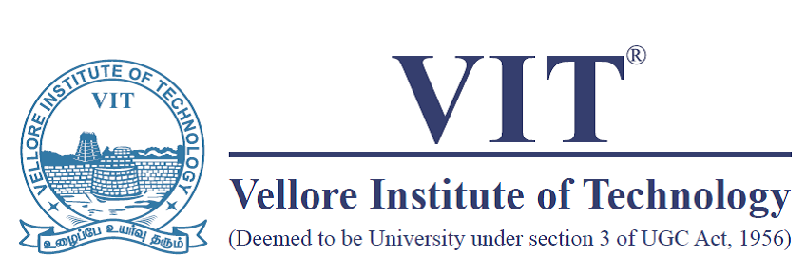
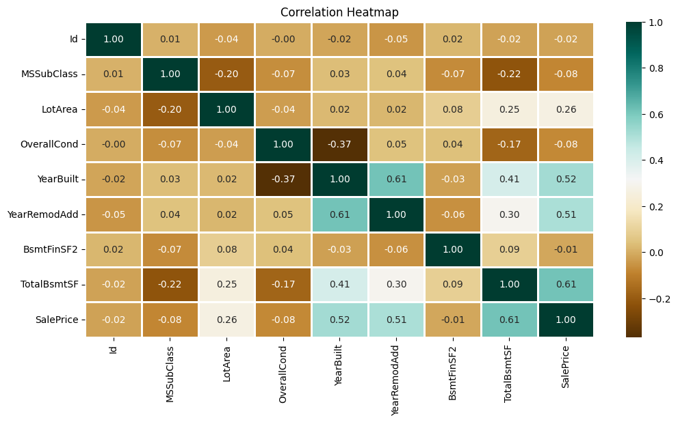
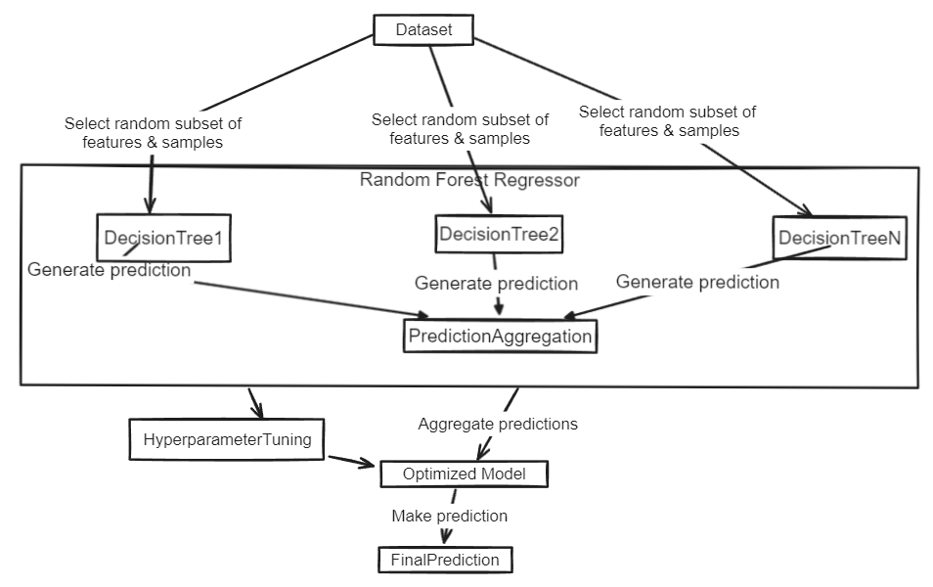
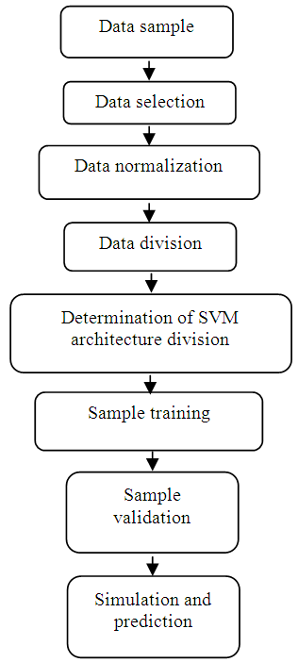
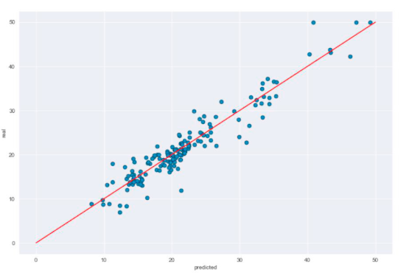
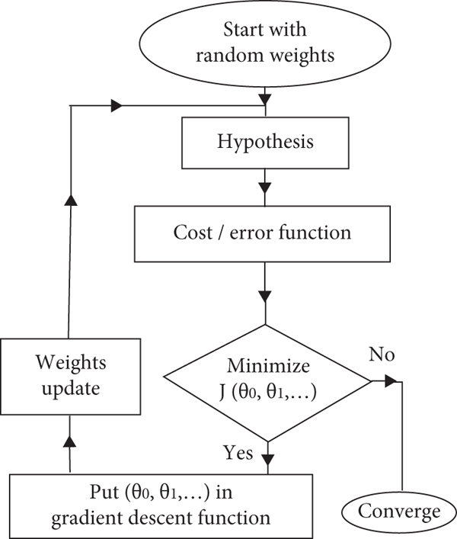
Working Model: Home Value Prediction
Artificial Intelligence (BITE308P)
Winter Semester (2023-24)
Repakula Yasoda Rushitha(21BIT0433), Aaditya V Menon(21BIT0454), Madhuranthakam S Kavya Sree(21BIT0483), Sneha Vejju(21BIT0647), Ishika Khandelwal (21BIT0657)
Guide: Prof.Hemalatha S / SCORE
Introduction
This is a Home Value Prediction project, dedicated to leveraging historical housing data and cutting-edge machine learning techniques to develop a predictive model for house prices. Our aim is to provide stakeholders in the real estate industry with valuable insights to improve efficiency, manage risks, and make informed decisions. Join us as we explore data-driven approaches to forecasting house prices, shaping the future of the real estate market.
Results
Heat maps serve various purposes like visualizing correlation, identifying patterns, feature selection, and model evaluation. By examining the heatmap below, we infer strong correlations between features, indicating interdependence. Positive correlation implies simultaneous increases or decreases in variables, while negative correlation suggests an increase in one variable corresponds to a decrease in another. Zero correlation indicates independence between variables.
Scope of the Project
The Home Value Prediction project follows a comprehensive methodology, covering every step from data acquisition to model deployment and maintenance. We begin by gathering historical housing data and relevant factors, followed by data cleansing and transformation. Through exploratory analysis, we unveil valuable insights and patterns within the dataset, train them on historical data, and rigorously evaluating their performance to ensure accurate predictions.
Methodology
For the Home Value Prediction model, we've employed a diverse set of machine learning algorithms, including Support Vector Machine (SVM), Random Forest Regressor, and Linear Regressor, to leverage their respective strengths and characteristics:
Support Vector Machine (SVM): SVM is a powerful algorithm for regression tasks that works by finding the hyperplane that best separates the data points into different classes. In regression, SVM aims to find the hyperplane that best fits the data while maximizing the margin between the hyperplane and the data points
Random Forest Regressor: Random Forest Regressor is an ensemble learning method that combines multiple decision trees to improve predictive accuracy. Each decision tree in the forest is trained on a random subset of the data and features, reducing overfitting and enhancing robustness.
Linear Regressor: Linear regression is a simple yet powerful algorithm that models the relationship between the independent variables (features) and the dependent variable (target) as a linear equation. It assumes a linear relationship between the features and the target variable and aims to minimize the sum of squared differences between the observed and predicted values.
By leveraging these diverse algorithms, we aim to capture the complexity of the housing market and provide accurate predictions that cater to various scenarios and requirements of stakeholders in the real estate industry.
Fig 2: Heat map
The Random Forest Regressor yielded promising results generated the Mean Absolute Percentage Error(MAPE) as 0.1929, meanwhile the SVM model with an explained variance of 0.3741, an R2 score of 0.3741 generated the MAPE as 0.1870 and the Linear Regressor model generated the MAPE as 0.1874. Here the SVM model gives the best accuracy with the least MAPE value. Hence the accuracy of the model was measured at 81.30%, with a narrow standard deviation of 0.28%.
Fig 1: Diagrammatical representation of all methods used
Fig 3 : Scatter Plot Real vs Predicted
Summary
The Home Value Prediction project harnesses historical data and advanced machine learning techniques to deliver precise forecasts. By examining factors such as location, size, amenities, and economic indicators, it provides actionable insights to stakeholders in the real estate industry. Utilizing a Random Forest Regressor model, the project achieves exceptional accuracy, empowering homeowners, buyers, sellers, and real estate professionals to anticipate market trends and streamline operations effectively.
Contact Details
Yasoda.rushita2021@vitstudent.ac.in | aaditya.vishwanath2021@vitstudent.ac.in | madhuran.skavyasree2021@vitstudent.ac.in | sneha.vejju2021@vitstudent.ac.in | ishika.khandelwal2021@vitstudent.ac.in .
Acknowledgments
I am so much thankful of Prof. Hemalatha S for guiding and encouraging us in this project.

